Slide 1
Introduction to Verilog
By- CHANDRAMOULI Haldar

Slide 2
What is Verilog?
Verilog is a Hardware Description Language (HDL) used to design and model digital systems.
It is used for:
FPGA Design
ASIC Design
RTL Design
Simulation of digital circuits
Testbench creation

Slide 3
Why Verilog is Used
Easy to learn (C-like syntax)
Widely used in industry
Supports simulation before fabrication
Used for FPGA & ASIC development
Supports behavioral, dataflow & structural modeling
Less strict compared to VHDL

Slide 4
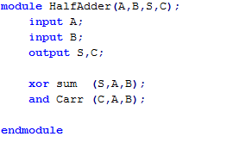
BASIC STRUCTURE OF Verilog
Verilog uses:
module → Defines hardware block
endmodule → End of block

Slide 5
Different Modeling Styles in VHDL
Dataflow Modeling
Behavioral Modeling
Structural Modeling

Slide 6
Dataflow Modeling
Uses continuous assignment (assign)
Example (AND Gate):
assign Y = A & B;
Simple
Used for combinational logic

Slide 7
Behavioral Modeling
Uses always block
always @(*) begin
if (A & B)
Y = 1;
else
Y = 0;
end
Used for complex logic
Uses if, case, loop

Slide 8
Structural Modeling
Connecting modules like hardware blocks.
and_gate g1 (.A(A), .B(B), .Y(Y));
Used for hierarchical design
Used in large VLSI systems

Slide 9
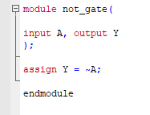
NOT Gate in Verilog

Slide 10

AND Gate

Slide 11

OR Gate

Slide 12
Practice
NAND
NOR
XOR
XNOR

Slide 13
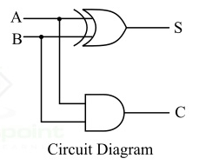
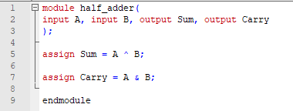
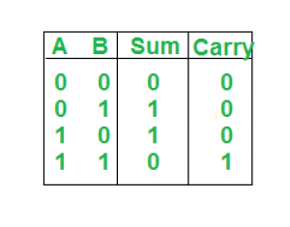
HALF ADDER

Slide 14
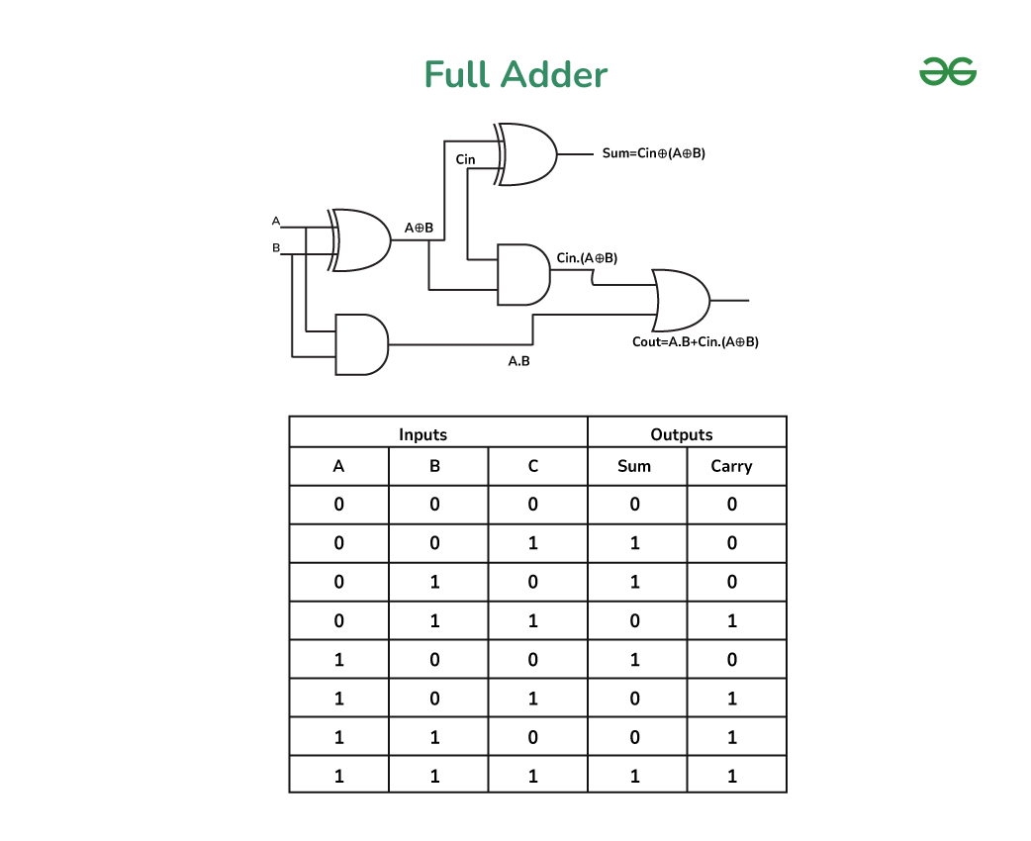

Slide 15
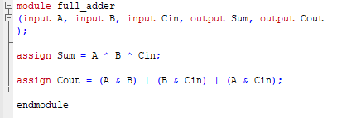
FULL ADDER

Slide 16
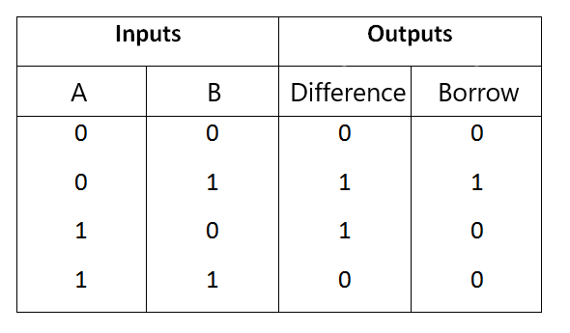
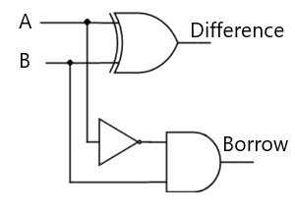
HALF SUBTRACTOR

Slide 17
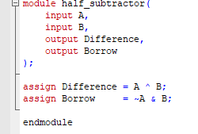
HALF SUBTRACTOR

Slide 18
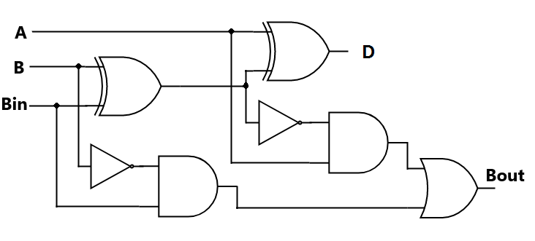
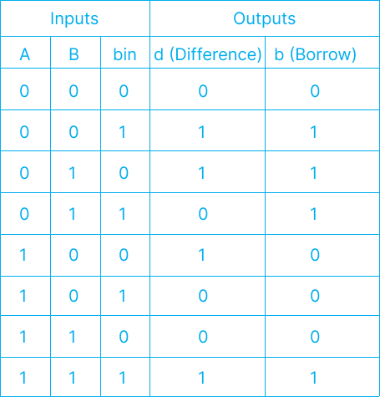
FULL SUBTRACTOR

Slide 19
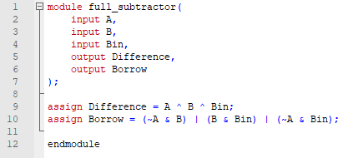
FULL SUBTRACTOR

Slide 20
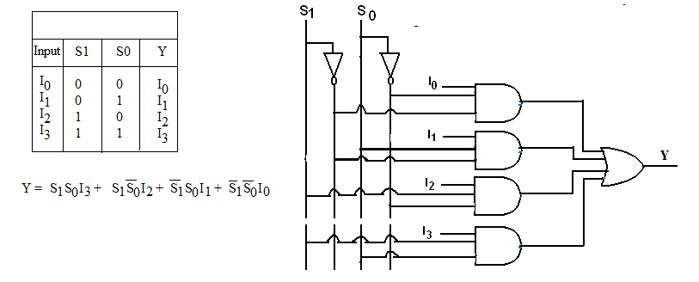
4:1 MULTIPLEXER

Slide 21
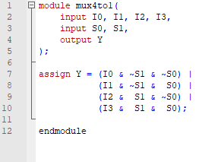
4:1 MULTIPLEXER

Slide 22
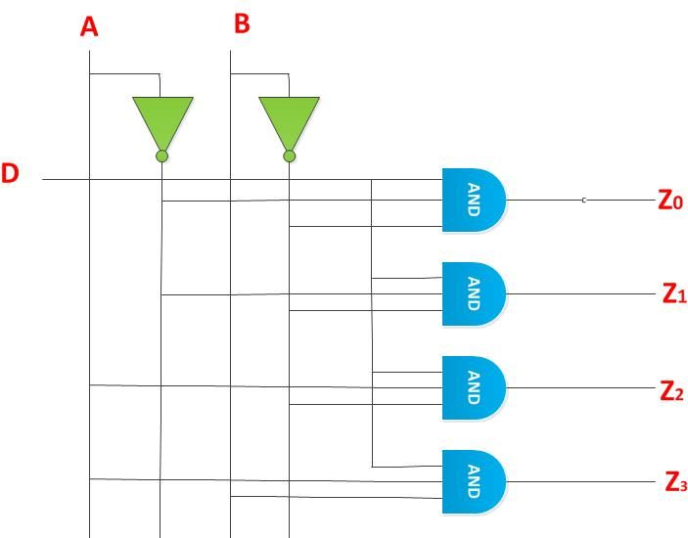
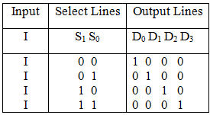
1:4 DEMULTIPLEXER

Slide 23
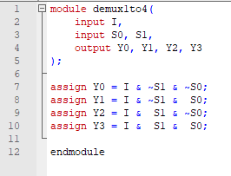
1:4 DEMULTIPLEXER

Slide 24
THANK YOU!
The class will end at 1:30, not before that.

